Slide 1
Automatic irrigation system for plants

Slide 2
Interfacing of DHT11 with Beagle bone black
Submitted by….,
Induja Sudhish(c0769921)
Group 6

Slide 3
Table of contents
Project overview
Components required
Introduction to Beagle bone black
Introduction to DHT11
Interfacing
Final result
References

Slide 4
Project overview
Our project automatic watering system for plants is an embedded system which automatically controls the irrigation of the plants. Different sensors are used to sense the data from the soil and water the plants accordingly.

Slide 5
Cont..
This temperature sensor will sense the surrounding air and measure the corresponding temperature and humidity values and this value is uploaded to the cloud and which can be accessed by the user.

Slide 6
Beaglebone black
The Beagle bone black Rev C still has a blistering 1GHz processor and 512MB onboard DDR3 RAM and like the rev B it has a AM3358 microprocessor, two 46-pin headers, micro HDMI for audio/video output, USB ports, 10/100 Ethernet and other I/O features.

Slide 7
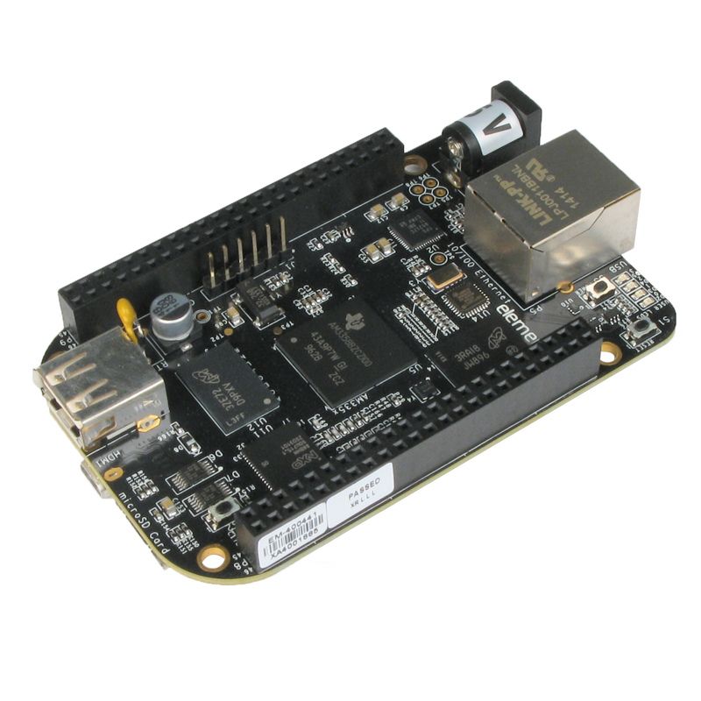
Cont..
The Rev C is an ultra-powered embedded computer that can fit in a mint tin.

Slide 8
Cont..
The rev C comes with a mini-B cable for powering it up ASAP. No microSD card is included as the BBB has onboard flash storage - and no SD card loading is required to get started.

Slide 9
Cont..
As the knowledge of users develops, the board provides more complicated interfaces including C/C++ functions to access digital and analog pins aboard the ARM Cortex A8 microprocessor.

Slide 10
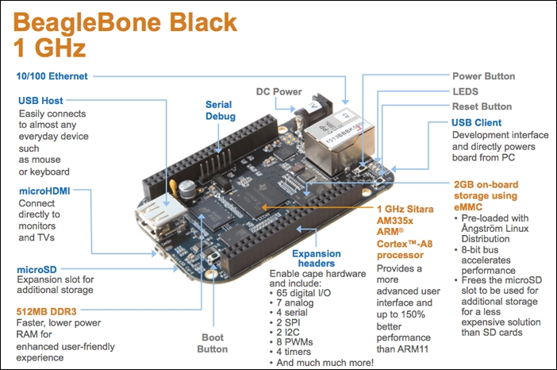
Specifications

Slide 11
Specifications
Processor: Sitara AM3358BZCZ100 1GHz, 2000 MIPS
Graphics Engine: SGX530 3D, 20M Polygons/S
SDRAM Memory: 512MB DDR3L 606MHZ
Onboard Flash: 4GB, 8bit Embedded MMC

Slide 12
Cont..
Power Source: miniUSB USB or DC Jack, 5VDC External Via Expansion Header
indicators 1-Power, 2-Ethernet, 4-User Controllable LEDs
HiSpeed USB 2.0 Client Port: Access to USB0, Client mode via miniUSB
HiSpeed USB 2.0 Host Port Access to USB1, Type A Socket, 500mA LS/FS/HS

Slide 13
Cont..
Serial Port UART0 access via 6 pin 3.3V TTL Header. Header is populated
Ethernet 10/100, RJ45
SD/MMC Connector microSD , 3.3V
User Input: Reset Button, Boot Button, Power Button

Slide 14
Cont..
Expansion Connectors: Power 5V, 3.3V ,VDD_ADC(1.8V)
3.3V I/O on all signals
McASP0, SPI1, I2C, GPIO(65), LCD, GPMC, MMC1, MMC2, 7 AIN(1.8V MAX), 4 Timers, 3 Serial Ports, CAN0, EHRPWM(0,2),XDMA Interrupt, Power button, Expansion Board ID (Up to 4 can be stacked)

Slide 15
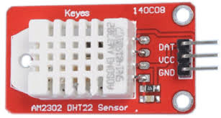
Temperature and Humidity Sensor (DHT11)
The DHT11 is a basic, low-cost digital temperature and humidity sensor.

Slide 16
Cont..
It uses a capacitive humidity sensor and a thermistor to measure the surrounding air, and spits out a digital signal on the data pin (no analog input pins needed)
They consist of a humidity sensing component, a NTC temperature sensor (or thermistor)
and an IC on the back side of the sensor.

Slide 17
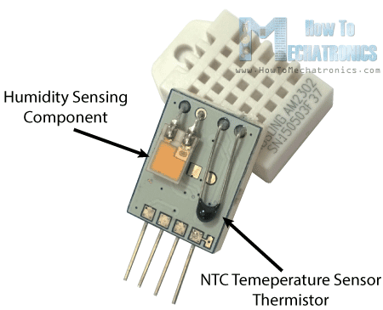
Cont….
For measuring humidity they use the
humidity sensing component which
has two electrodes with moisture
holding substrate between them.

Slide 18
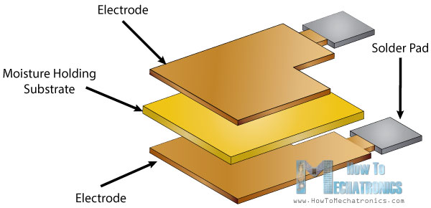
Cont…
So as the humidity changes, the conductivity of the substrate changes or the resistance between these electrodes changes. This change in resistance is measured and processed by the IC which makes it ready to be read by a microcontroller.

Slide 19
Cont…
There is also a very basic chip inside that does some analog to digital conversion and spits out a digital signal with the temperature and humidity.
Technical details:
Power: 3-5V
Max Current: 2.5mA
Humidity: 0-100%, 2-5% accuracy
Temperature: -40 to 80°C, ±0.5°C accuracy

Slide 20
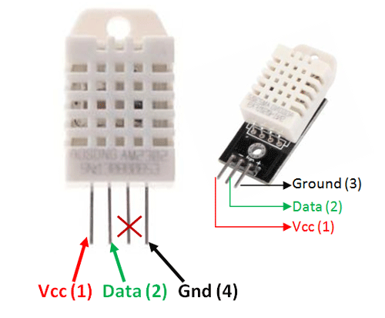
Cont..
Connections are simple, the first
pin on the left to 3-5V power,
the second pin to your data input pin
and the right most pin to ground.

Slide 21
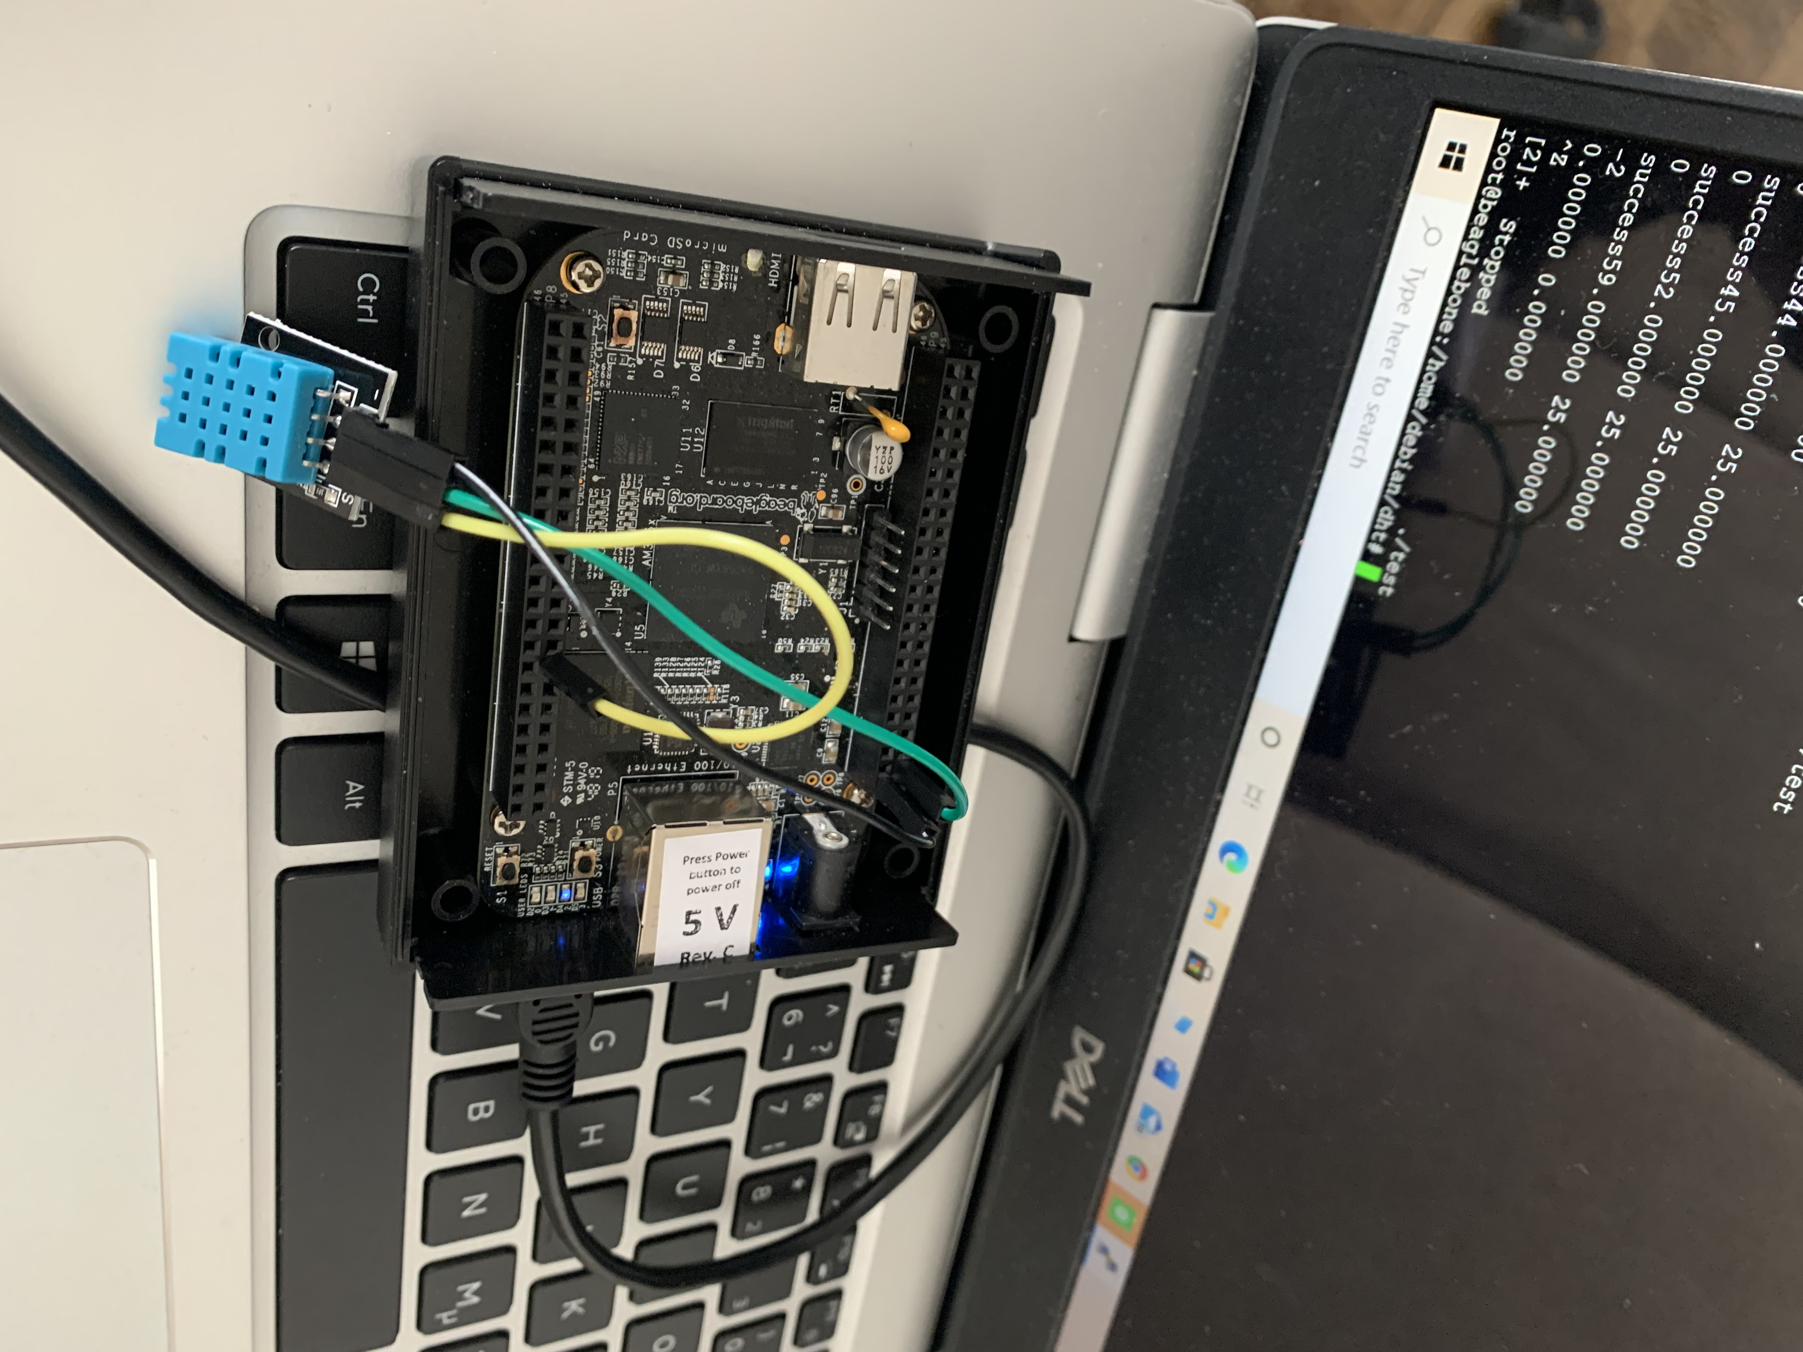
Interfacing

Slide 22
The dht11 sensor is connected to the BBB as a first step.
DHT11 sensor | Beagle bone black
VCC | P9_3
data | P8_15
ground | P9_1

Slide 23
Next we have to login to the putty by using the ip address 192.168.7.2
Login as Debian and enter the password as temppwd.
Go to the root by entering the command sudo su.

Slide 24
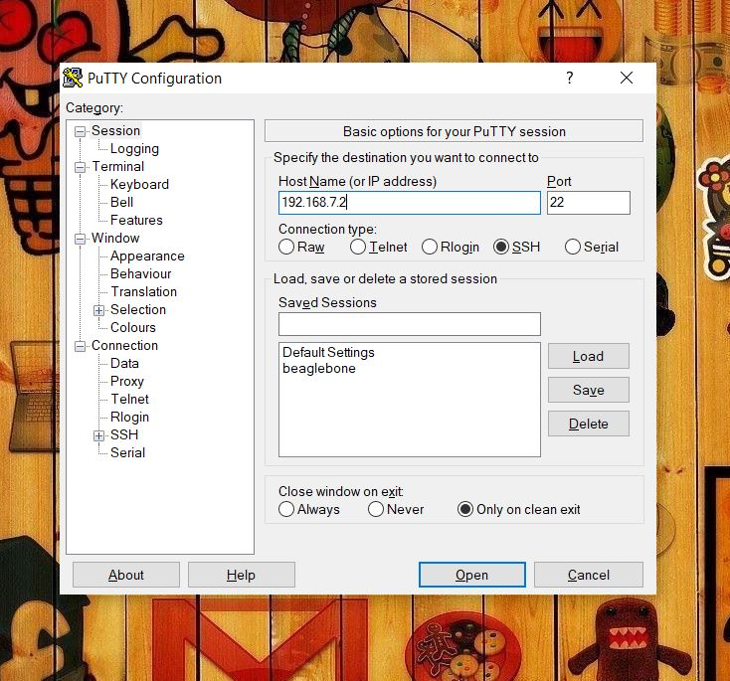
Steps:

Slide 25
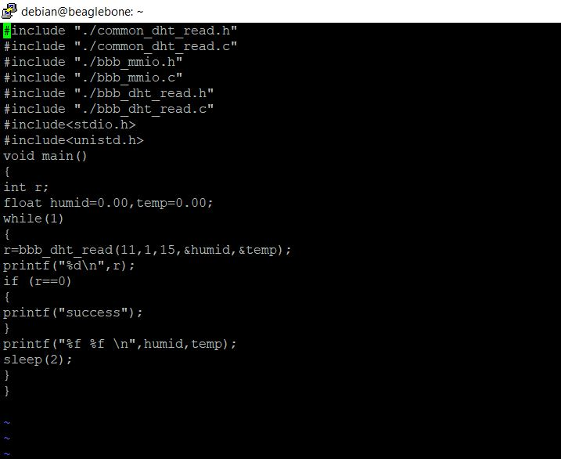

Slide 26
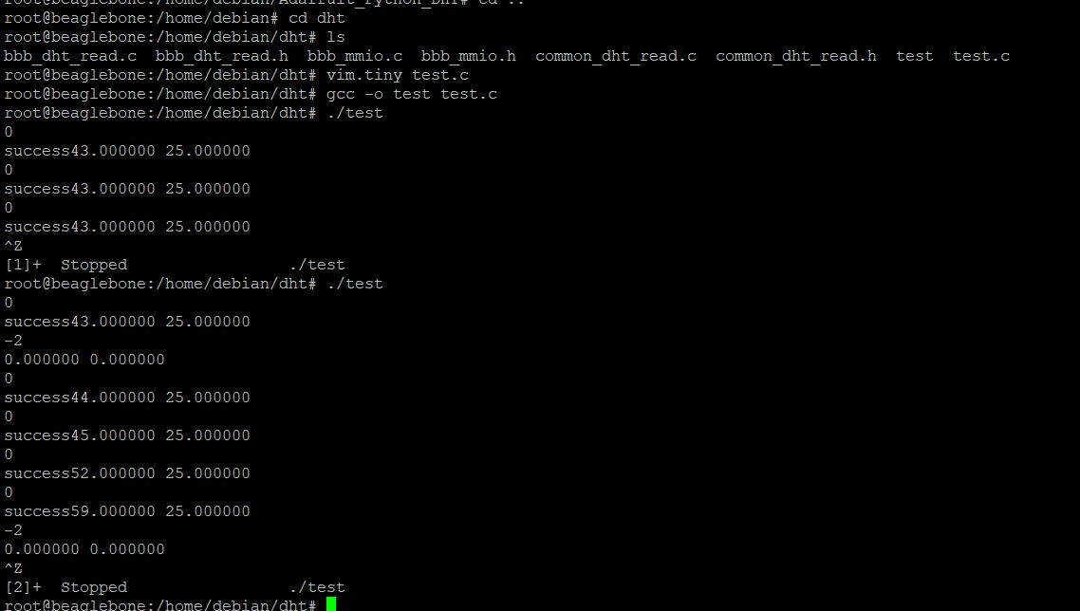
Output

Slide 27
References
Beaglebone black: https://beagleboard.org/black
DHT sensor: https://howtomechatronics.com/tutorials/arduino/dht11-dht22-sensors-temperature-and-humidity-tutorial-using-arduino/

Slide 28
Interfacing of dht11:
https://www.adafruit.com/product/386
Libraries :
https://github.com/adafruit/Adafruit_CircuitPython_DHT

Slide 29
THANKS!

